Slide 1
MYSQL
Contents
Introduction to SQL
DDL
DML
Select statement
Where Clause with comparison operator (<, >, <=, >=, < >, = =)
Where clause, IS NULL, IS NOT NULL
Special operators: Between, like wild cards (_, %), order by, distinct, limit
Aggregate functions: (count, max, min, sum, avg)
Group by and Having Clause.
Multi-table Select(Cross Product),
Joins(Inner, Natural),
Outer Joins(Left, Right, Full)
Simple Nested Query
Using IN, ANY and ALL.
Co-related Nested Query using Exists and Not Exists.

Slide 2
Introduction to SQL
Spring 2023

Slide 3
SQL: Structured Query Language
The standard for relational database management systems (RDBMS)
MySQL is an open-source relational database management system (RDBMS).
RDBMS:
A database management system that manages data as a collection of tables in which all relationships are represented by common values in related tables

Slide 4
Purpose of SQL Standard
Specify syntax/semantics for data definition and manipulation
Define data structures and basic operations
Enable portability of database definition and application modules
Specify minimal (level 1) and complete (level 2) standards
Allow for later growth/enhancement to standard

Slide 5
Benefits of a Standardized Relational Language
Reduced training costs
Productivity
Application portability
Application longevity
Reduced dependence on a single vendor
Cross-system communication

Slide 6
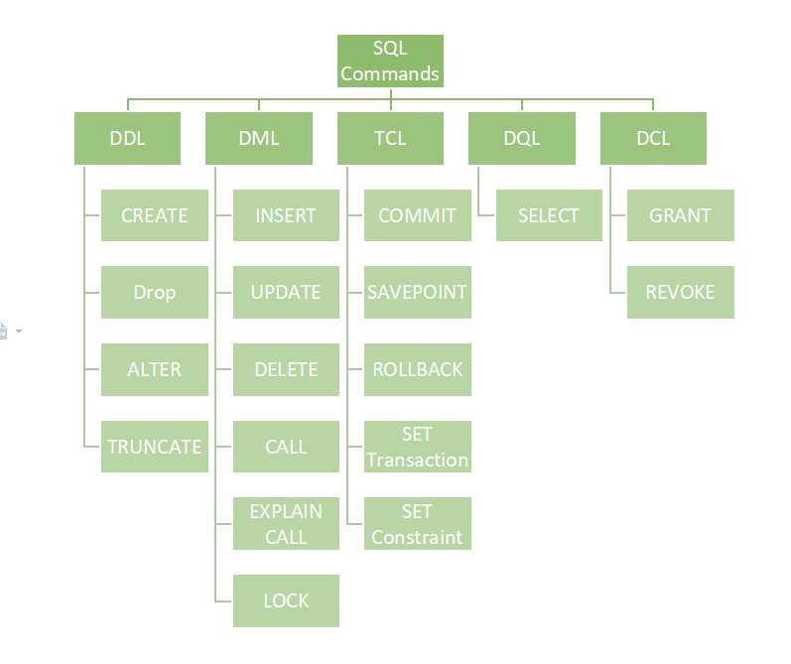
SQL Environment
Catalog
A set of schemas that constitute the description of a database
Schema
The structure that contains descriptions of objects created by a user (base tables, views, constraints)
Data Definition Language (DDL)
Commands that define a database, including creating, altering, and dropping tables and establishing constraints
Data Manipulation Language (DML) – our focus
Commands that maintain and query a database
Data Control Language (DCL)
Commands that control a database, including administering privileges and committing data

Slide 7
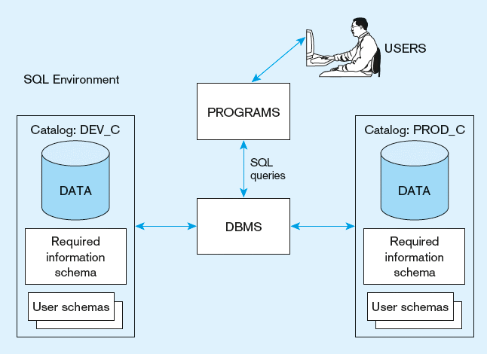
A simplified schematic of a typical SQL environment, as described by the SQL: 200n standard

Slide 8
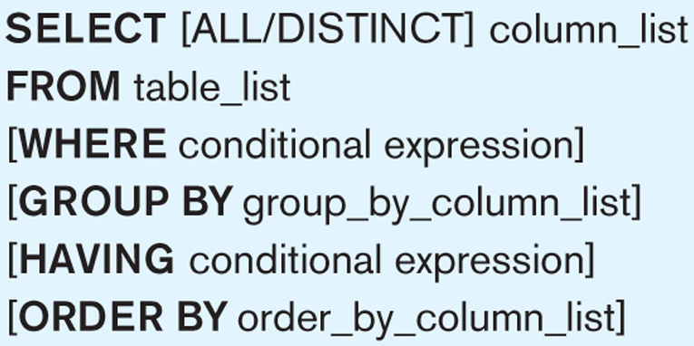
Query syntax
Display order can be specified here
Cond for records
Cond for groups
SELECT Major, AVERAGE(GPA) , GraduateYr
WHERE GraduateYr = “2021”
GROUP BY Major
HAVING AVERAGE(GPA) >=3.0
ORDER BY Major
Just a quick example to show sequence of clauses

Slide 9
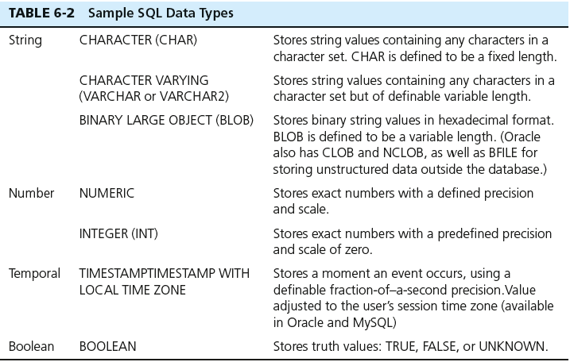
SQL Data Types

Slide 11
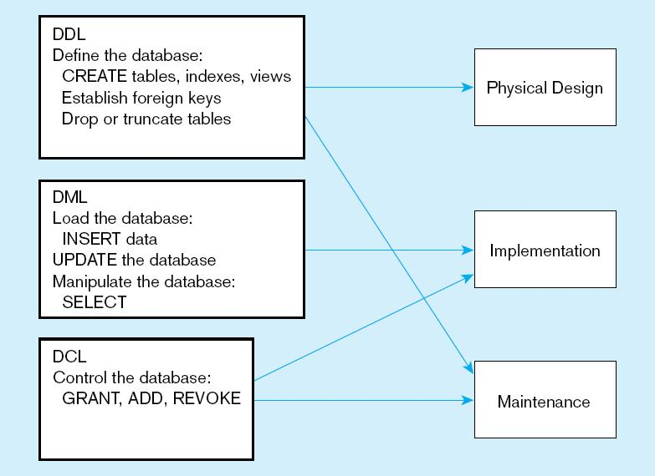
DDL, DML, DCL, and the database development process

Slide 12
SQL Database Definition
Data Definition Language (DDL)
Major CREATE statements:
CREATE SCHEMA–defines a portion of the database owned by a particular user
CREATE TABLE–defines a new table and its columns
CREATE VIEW–defines a logical table from one or more tables or views

Slide 13
DATABASE/SCHEMA
CREATE {DATABASE | SCHEMA} [IF NOT EXISTS] db_name
[create_option] ...
create_option: [DEFAULT]
{ CHARACTER SET [=] charset_name
| COLLATE [=] collation_name
| ENCRYPTION [=] {'Y' | 'N’} }
SHOW DATABASES
DROP DATABASE db_name
BACKUP DATABASE testDB TO DISK = 'D:\backups\testDB.bak’; WITH DIFFERENTIAL;
Notes:
A differential back up reduces the back up time

Slide 14
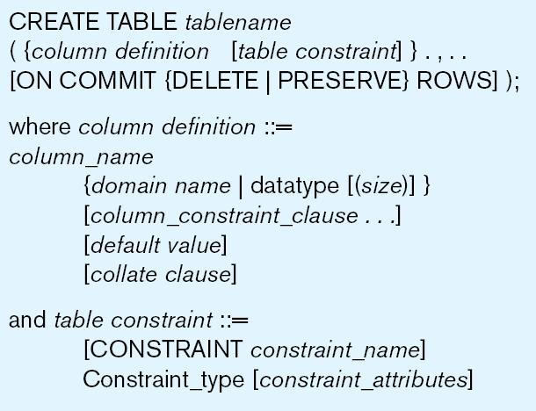
Table Creation
General syntax for CREATE TABLE statement used in data definition language
Steps in table creation:
Identify data types for attributes
Identify columns that can and cannot be null
Identify columns that must be unique (candidate keys)
Identify primary key–foreign key mates
Determine default values
Identify constraints on columns (domain specifications)
Create the table and associated indexes

Slide 15
CREATE TABLE table_name ( column1 datatype, column2 datatype, column3 datatype, .... );
CREATE TABLE new_table_name AS SELECT column1, column2,... FROM existing_table_name WHERE ....;
CREATE TABLE Persons ( PersonID int, LastName varchar(255), FirstName varchar(255), Address varchar(255), City varchar(255) );
DESC table_name;
DROP TABLE table_name;
TRUNCATE TABLE table_name;
Notes:
The TRUNCATE TABLE statement is used to delete the data inside a table, but not the table itself.

Slide 16
SQL Constraints
NOT NULL - Ensures that a column cannot have a NULL value
CREATE TABLE Persons ( ID int NOT NULL, LastName varchar(255) NOT NULL, FirstName varchar(255) NOT NULL, Age int );
UNIQUE - Ensures that all values in a column are different
CREATE TABLE Persons ( ID int NOT NULL, LastName varchar(255) NOT NULL, FirstName varchar(255), Age int, CONSTRAINT UC_Person UNIQUE (ID,LastName) );
PRIMARY KEY - A combination of a NOT NULL and UNIQUE. Uniquely identifies each row in a table
CREATE TABLE Persons ( ID int NOT NULL, LastName varchar(255) NOT NULL, FirstName varchar(255), Age int, CONSTRAINT PK_Person PRIMARY KEY (ID,LastName) );

Slide 17
FOREIGN KEY - Prevents actions that would destroy links between tables
CREATE TABLE Orders ( OrderID int NOT NULL, OrderNumber int NOT NULL, PersonID int, PRIMARY KEY (OrderID), CONSTRAINT FK_PersonOrder FOREIGN KEY (PersonID) REFERENCES Persons(PersonID) );
CREATE TABLE child_table ( column1 datatype [ NULL | NOT NULL ], column2 datatype [ NULL | NOT NULL ], ... CONSTRAINT fk_name FOREIGN KEY (child_col1, child_col2, ... child_col_n) REFERENCES parent_table (parent_col1, parent_col2, ... parent_col_n) ON DELETE CASCADE [ ON UPDATE { NO ACTION | CASCADE | SET NULL | SET DEFAULT } ] );
CHECK - Ensures that the values in a column satisfies a specific condition
CREATE TABLE Persons ( ID int NOT NULL, LastName varchar(255) NOT NULL, FirstName varchar(255), Age int, CHECK (Age>=18) );

Slide 18
DEFAULT - Sets a default value for a column if no value is specified
CREATE TABLE Orders ( ID int NOT NULL, OrderNumber int NOT NULL, OrderDate date DEFAULT GETDATE() );
CREATE INDEX - Used to create and retrieve data from the database very quickly
CREATE UNIQUE INDEX index_name ON table_name (column1, column2, ...);
Auto-increment allows a unique number to be generated automatically when a new record is inserted into a table.
CREATE TABLE Persons ( Personid int NOT NULL AUTO_INCREMENT, LastName varchar(255) NOT NULL, FirstName varchar(255), Age int, PRIMARY KEY (Personid) );

Slide 19
CREATE VIEWS
A view is a virtual table based on the result-set of an SQL statement.
A view contains rows and columns, just like a real table. The fields in a view are fields from one or more real tables in the database.
CREATE VIEW [Brazil Customers] AS SELECT CustomerName, ContactName FROM Customers WHERE Country = 'Brazil';

Slide 20
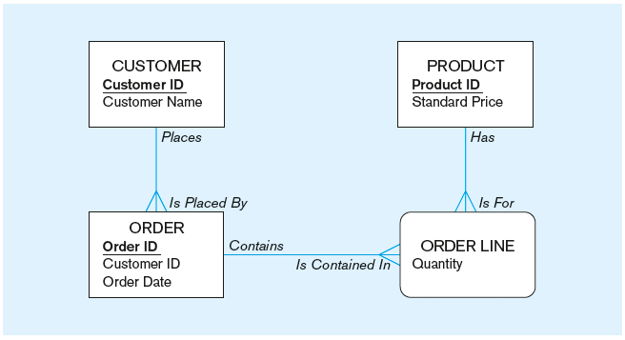
create tables for this enterprise data model

Slide 21
SQL(DML)

Slide 22
INSERT, UPDATE and Delete
INSERT: adding records based on the existing table
INSERT INTO CUSTOMER_T VALUES (… )
INSERT INTO table_name (column1, column2, column3, ...) VALUES (value1, value2, value3, ...);
insert into table1 values (5, DEFAULT, 10, DEFAULT)
UPDATE: changing the values of some fields in existing records
UPDATE PRODUCT_T SET …WHERE…
UPDATE table_name SET column1 = value1, column2 = value2, ... WHERE condition;
DELETE: Removing the record from the table.
DELETE FROM table_name WHERE condition;

Slide 23
Specifying Updates in SQL
There are three SQL commands to modify the database; INSERT, DELETE, and UPDATE

Slide 24
INSERT
In its simplest form, it is used to add one or more tuples to a relation
Attribute values should be listed in the same order as the attributes were specified in the CREATE TABLE command

Slide 25
INSERT (cont.)
Example: U1: INSERT INTO EMPLOYEE VALUES ('Richard','K','Marini', '653298653', '30-DEC-52', '98 Oak Forest,Katy,TX', 'M', 37000,'987654321', 4 );
An alternate form of INSERT specifies explicitly the attribute names that correspond to the values in the new tuple
Attributes with NULL values can be left out
Example: Insert a tuple for a new EMPLOYEE for whom we only know the FNAME, LNAME, and SSN attributes. U1A: INSERT INTO EMPLOYEE (FNAME, LNAME, SSN) VALUES ('Richard', 'Marini', '653298653');

Slide 26
INSERT (cont.)
Example: Suppose we want to create a temporary table
INSERT INTO WORKS_ON_INFO ( Emp_name, Proj_name,Hours_per_week)
SELECT E.Lname, P.Pname, W.Hours
FROM PROJECT P, WORKS_ON W, EMPLOYEE E
WHERE P.Pnumber=W.Pno AND W.Essn=E.Ssn;

Slide 27
DELETE
Removes tuples from a relation
Includes a WHERE-clause to select the tuples to be deleted
Tuples are deleted from only one table at a time (unless CASCADE is specified on a referential integrity constraint)
A missing WHERE-clause specifies that all tuples in the relation are to be deleted; the table then becomes an empty table
The number of tuples deleted depends on the number of tuples in the relation that satisfy the WHERE-clause
Referential integrity should be enforced

Slide 28
DELETE (cont.)
Examples: U4A: DELETE FROM EMPLOYEE WHERE LNAME='Brown’; U4B: DELETE FROM EMPLOYEE WHERE SSN='123456789’; U4C: DELETE FROM EMPLOYEE WHERE DNO =5; U4D: DELETE FROM EMPLOYEE;

Slide 29
UPDATE
Used to modify attribute values of one or more selected tuples
A WHERE-clause selects the tuples to be modified
An additional SET-clause specifies the attributes to be modified and their new values
Each command modifies tuples in the same relation
Referential integrity should be enforced

Slide 30
UPDATE (cont.)
Example: Change the location and controlling department number of project number 10 to ‘Sydney' and 5, respectively. U5: UPDATE PROJECT SET PLOCATION = ‘Sydney’,
DNUM = 5 WHERE PNUMBER=10

Slide 31
UPDATE (cont.)
Example: Give all employees in the 'Research' department a 10% raise in salary. U6: UPDATE EMPLOYEE SET SALARY = SALARY *1.1 WHERE dno =5;
In this request, the modified SALARY value depends on the original SALARY value in each tuple
The reference to the SALARY attribute on the right of = refers to the old SALARY value before modification
The reference to the SALARY attribute on the left of = refers to the new SALARY value after modification

Slide 32
Retrieval Queries in SQL
SQL has one basic statement for retrieving information from a database; the SELECT statement
This is not the same as the SELECT operation of the relational algebra
Important distinction between SQL and the formal relational model; SQL allows a table (relation) to have two or more tuples that are identical in all their attribute values
Hence, an SQL relation (table) is a multi-set (sometimes called a bag) of tuples; it is not a set of tuples
SQL relations can be constrained to be sets by specifying PRIMARY KEY or UNIQUE attributes, or by using the DISTINCT option in a query

Slide 33
SELECT
= | Equal
> | Greater than
< | Less than
>= | Greater than or equal
<= | Less than or equal
<> | Not equal. Note: In some versions of SQL this operator may be written as !=
BETWEEN | Between a certain range
LIKE | Search for a pattern
IN | To specify multiple possible values for a column
The SELECT statement is used to select data from a database.
The data returned is stored in a result table, called the result-set.
SELECT * FROM table_name;
The WHERE clause is used to filter records.
It is used to extract only those records that fulfill a specified condition.

Slide 34
Retrieval Queries in SQL (cont.)
Basic form of the SQL SELECT statement is called a mapping or a SELECT-FROM-WHERE block
SELECT <attribute list>
FROM <table list>
WHERE <condition>
<attribute list> is a list of attribute names whose values are to be retrieved by the query
<table list> is a list of the relation names required to process the query
<condition> is a conditional (Boolean) expression that identifies the tuples to be retrieved by the query

Slide 35
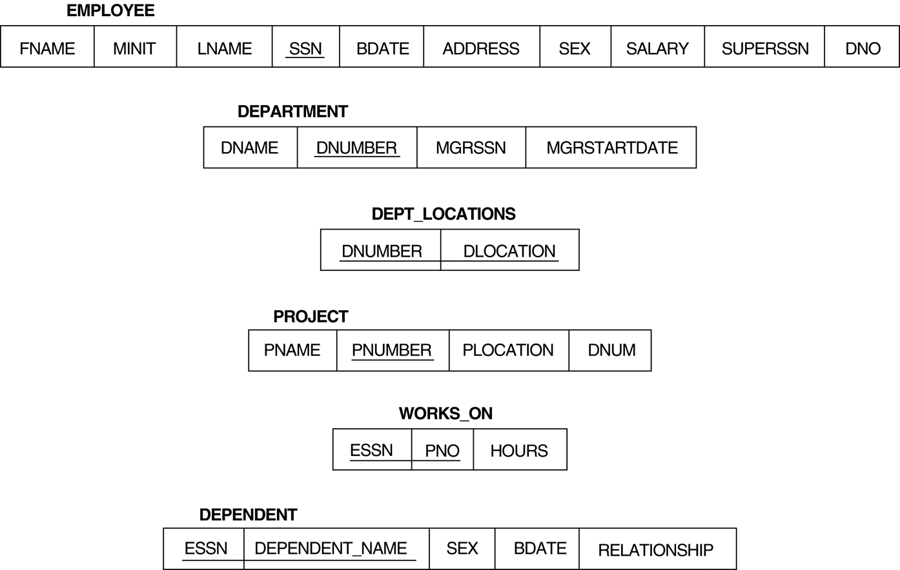
Relational Database Schema--Figure 5.5

Slide 36
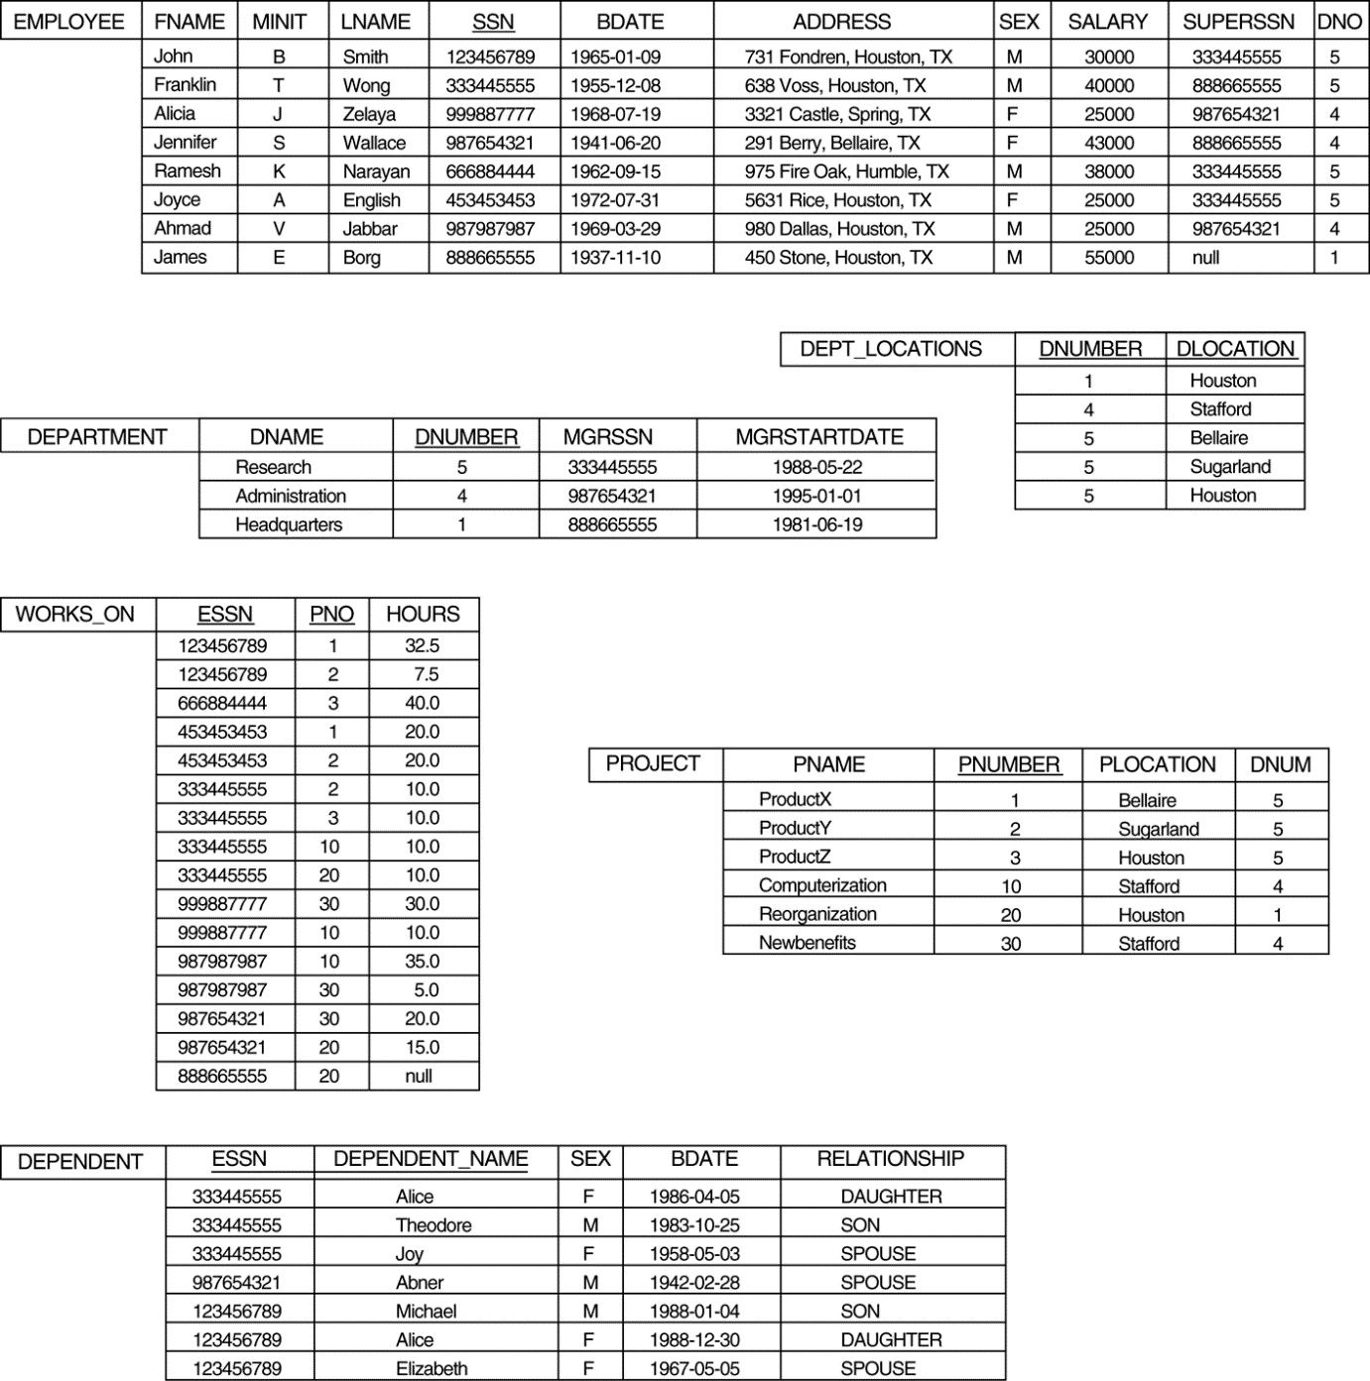
Populated Database--Fig.5.6

Slide 37
Simple SQL Queries
Basic SQL queries correspond to using the SELECT, PROJECT, and JOIN operations of the relational algebra
All subsequent examples use the COMPANY database
Example of a simple query on one relation
Query 0: Retrieve the birthdate and address of the employee whose name is 'John B. Smith'.
Q0: SELECT BDATE, ADDRESS FROM EMPLOYEE WHERE FNAME='John' AND MINIT=‘B’ AND LNAME='Smith’
Similar to a SELECT-PROJECT pair of relational algebra operations; the SELECT-clause specifies the projection attributes and the WHERE-clause specifies the selection condition
However, the result of the query may contain duplicate tuples

Slide 38
Simple SQL Queries (cont.)
Query 1: Retrieve the name and address of all employees who work for the 'Research' department.
Q1: SELECT FNAME, LNAME, ADDRESS FROM EMPLOYEE, DEPARTMENT WHERE DNAME='Research' AND DNUMBER=DNO
Similar to a SELECT-PROJECT-JOIN sequence of relational algebra operations
(DNAME='Research') is a selection condition (corresponds to a SELECT operation in relational algebra)
(DNUMBER=DNO) is a join condition (corresponds to a JOIN operation in relational algebra)

Slide 39
Simple SQL Queries (cont.)
Query 2: For every project located in 'Stafford', list the project number, the controlling department number, and the department manager's last name, address, and birthdate.
Q2: SELECT PNUMBER, DNUM, LNAME, BDATE, ADDRESS FROM PROJECT, DEPARTMENT, EMPLOYEE WHERE DNUM=DNUMBER AND MGRSSN=SSN AND PLOCATION='Stafford'
In Q2, there are two join conditions
The join condition DNUM=DNUMBER relates a project to its controlling department
The join condition MGRSSN=SSN relates the controlling department to the employee who manages that department

Slide 40
Aliases, * and DISTINCT, Empty WHERE-clause
In SQL, we can use the same name for two (or more) attributes as long as the attributes are in different relations A query that refers to two or more attributes with the same name must qualify the attribute name with the relation name by prefixing the relation name to the attribute name
Example:
EMPLOYEE.LNAME, DEPARTMENT.DNAME

Slide 41
ALIASES
Some queries need to refer to the same relation twice
In this case, aliases are given to the relation name
Query 8: For each employee, retrieve the employee's name, and the name of his or her immediate supervisor. Q8: SELECT E.FNAME, E.LNAME, S.FNAME, S.LNAME FROM EMPLOYEE E S WHERE E.SUPERSSN=S.SSN
In Q8, the alternate relation names E and S are called aliases or tuple variables for the EMPLOYEE relation
We can think of E and S as two different copies of EMPLOYEE; E represents employees in role of supervisees and S represents employees in role of supervisors

Slide 42
ALIASES (cont.)
Aliasing can also be used in any SQL query for convenience Can also use the AS keyword to specify aliases Q8: SELECT E.FNAME, E.LNAME, S.FNAME, S.LNAME FROM EMPLOYEE AS E, EMPLOYEE AS S WHERE E.SUPERSSN=S.SSN

Slide 43
UNSPECIFIED WHERE-clause
A missing WHERE-clause indicates no condition; hence, all tuples of the relations in the FROM-clause are selected
This is equivalent to the condition WHERE TRUE
Query 9: Retrieve the SSN values for all employees.
Q9: SELECT SSN FROM EMPLOYEE
If more than one relation is specified in the FROM-clause and there is no join condition, then the CARTESIAN PRODUCT of tuples is selected

Slide 44
UNSPECIFIED WHERE-clause (cont.)
Example: Q10: SELECT SSN, DNAME FROM EMPLOYEE, DEPARTMENT
It is extremely important not to overlook specifying any selection and join conditions in the WHERE-clause; otherwise, incorrect and very large relations may result

Slide 45
USE OF * (Wildcard)
To retrieve all the attribute values of the selected tuples, a * is used, which stands for all the attributes Examples:
Q1C: SELECT * FROM EMPLOYEE WHERE DNO=5 Q1D: SELECT * FROM EMPLOYEE, DEPARTMENT WHERE DNAME='Research' AND DNO=DNUMBER

Slide 46
USE OF DISTINCT
SQL does not treat a relation as a set; duplicate tuples can appear
To eliminate duplicate tuples in a query result, the keyword DISTINCT is used
For example, the result of Q11 may have duplicate SALARY values whereas Q11A does not have any duplicate values
Q11: SELECT SALARY FROM EMPLOYEE
Q11A: SELECT DISTINCT SALARY FROM EMPLOYEE

Slide 47
SET OPERATIONS
SQL has directly incorporated some set operations
There is a union operation (UNION), and in some versions of SQL there are set difference (MINUS) and intersection (INTERSECT) operations
The resulting relations of these set operations are sets of tuples; duplicate tuples are eliminated from the result
The set operations apply only to union compatible relations ; the two relations must have the same attributes and the attributes must appear in the same order

Slide 48
SUBSTRING COMPARISON
The LIKE comparison operator is used to compare partial strings
reserved characters used: '%' , ‘_’
replaces an arbitrary number of characters, and '_' replaces a single arbitrary character

Slide 49
SUBSTRING COMPARISON (cont.)
Query 25: Retrieve all employees whose address is in Houston, Texas. Here, the value of the ADDRESS attribute must contain the substring 'Houston,TX'. Q25: SELECT FNAME, LNAME FROM EMPLOYEE WHERE ADDRESS LIKE '%Houston,TX%’

Slide 50
SUBSTRING COMPARISON (cont.)
Query 26: Retrieve all employees who were born during the 1950s. Here, '5' must be the 3rd character of the string (according to our format for date), so the BDATE value is '__5______', with each underscore as a place holder for a single arbitrary character. Q26: SELECT FNAME, LNAME FROM EMPLOYEE WHERE BDATE LIKE '_ _ 5 _ _ _ _ _ _ _’

Slide 51
ARITHMETIC OPERATIONS
The standard arithmetic operators '+', '-'. '*', and '/' (for addition, subtraction, multiplication, and division, respectively) can be applied to numeric values in an SQL query result
Query 27: Show the effect of giving all employees who work on the 'ProductX' project a 10% raise. Q27: SELECT FNAME, LNAME, 1.1*SALARY FROM EMPLOYEE, WORKS_ON, PROJECT WHERE SSN=ESSN AND PNO=PNUMBER AND PNAME='ProductX’

Slide 52
Comparison Operator BETWEEN
Query:
Retrieve all employees in department 5 whose salary is between 30,000 and 50,000
SELECT *
FROM EMPLOYEE
WHERE (Salary BETWEEN 30000 AND 50000) AND DNO =5 ;
SAME AS
(Salary >= 30000)AND (Salary <= 50000)

Slide 53
ORDER BY
The ORDER BY clause is used to sort the tuples in a query result based on the values of some attribute(s)
Query : Retrieve a list of employees and the projects each works in, ordered by the employee's department, and within each department ordered alphabetically by employee last name.

Slide 54
Answer:
SELECT DNAME, LNAME, FNAME, PNAME FROM DEPARTMENT, EMPLOYEE,WORKS_ON, PROJECT WHERE DNUMBER=DNO AND SSN=ESSN AND PNO=PNUMBER ORDER BY DNAME, LNAME

Slide 55
ORDER BY (cont.)
The default order is in ascending order of values
We can specify the keyword DESC if we want a descending order; the keyword ASC can be used to explicitly specify ascending order, even though it is the default

Slide 56
Limit
The LIMIT clause is used in the SELECT statement to constrain the number of rows to return. The LIMIT clause accepts one or two arguments. The values of both arguments must be zero or positive integers.
select all records from 1 - 30 (inclusive) from a table called "Orders"
SELECT * FROM Orders LIMIT 30
return only 10 records, start on record 16 (OFFSET 15)
SELECT * FROM Orders LIMIT 10 OFFSET 15
SELECT * FROM Orders LIMIT 15, 10

Slide 57
AND, OR, NOT
SELECT * FROM Customers WHERE Country = 'Pakistan' AND City = 'Lahore';
SELECT * FROM Customers WHERE City = 'Lahore’ OR City = 'Islamabad’;
SELECT * FROM Customers WHERE NOT Country = 'Germany’;

Slide 58
Operator | Description | Example
= | Equal | SELECT * FROM Products WHERE Price = 18;
> | Greater than | SELECT * FROM Products WHERE Price > 20;
< | Less than | SELECT * FROM Products WHERE Price < 18;
>= | Greater than or equal | SELECT * FROM Products WHERE Price <= 18;
<= | Less than or equal | SELECT * FROM Products WHERE Price >= 18;
<> | Not equal. Note: In some versions of SQL this operator may be written as != | SELECT * FROM Products WHERE Price <> 18; SELECT * FROM Products WHERE Price != 18;
BETWEEN | Between a certain range | SELECT * FROM Products WHERE Price BETWEEN 50 AND 60;
LIKE | Search for a pattern | SELECT * FROM Customers WHERE City LIKE 's%';
IN | To specify multiple possible values for a column | SELECT * FROM Customers WHERE City IN ('Paris','London');

Slide 59

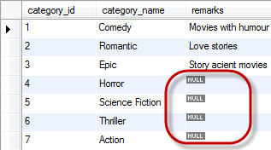
Null in mysql
Null as a Value
In simple terms, NULL is simply a place holder for data that does not exist. When performing insert operations on tables, they will be times when some field values will not be available.
NULL is not a data type – this means it is not recognized as an “int”, “date” or any other defined data type.
Arithmetic operations involving NULL always return NULL for example, 69 + NULL = NULL.
All aggregate functions affect only rows that do not have NULL values.

Slide 60
Null in mysql
“IS NULL” is the keyword that performs the Boolean comparison. It returns true if the supplied value is NULL and false if the supplied value is not NULL.
SELECT * FROM members WHERE contact_number IS NULL;
“NOT NULL” is the keyword that performs the Boolean comparison. It returns true if the supplied value is not NULL and false if the supplied value is null.
SELECT * FROM members WHERE contact_number IS NOT NULL;

Slide 61
Null in mysql
NULL is a value place holder for optional table fields.
MySQL treats the NULL value differently from other data types. The NULL values when used in a condition evaluates to the false Boolean value.
The NOT logical operate is used to test for Boolean values and evaluates to true if the Boolean value is false and false if the Boolean value is true.
The NOT NULL clause is used to eliminate NULL values from a result set
Performing arithmetic operations on NULL values always returns NULL results.
The comparison operators such as [, =, etc.] cannot be used to compare NULL values.

Slide 62
Alias
Aliases can be useful when:
There are more than one table involved in a query
Functions are used in the query
Column names are big or not very readable
Two or more columns are combined together
SELECT o.OrderID, o.OrderDate AS 'Order date', c.CustomerName FROM Customers AS c, Orders AS o WHERE c.CustomerName='Around the Horn' AND c.CustomerID=o.CustomerID;

Slide 63
SET Operations in SQL
SQL supports few Set operations which can be performed on the table data. These are used to get meaningful results from data stored in the table, under different special conditions.
UNION
UNION ALL
INTERSECT
MINUS

Slide 64
UNION
UNION is used to combine the results of two or more SELECT statements. However it will eliminate duplicate rows from its resultset. In case of union, number of columns and datatype must be same in both the tables, on which UNION operation is being applied.
SELECT * FROM First
UNION
SELECT * FROM Second;
Union all
This operation is similar to Union. But it also shows the duplicate rows.
SELECT * FROM First UNION ALL SELECT * FROM Second;

Slide 65
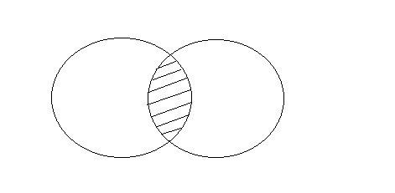

INTERSECT
Intersect operation is used to combine two SELECT statements, but it only returns the records which are common from both SELECT statements. In case of Intersect the number of columns and datatype must be same.
NOTE: MySQL does not support INTERSECT operator.
SELECT * FROM First
INTERSECT SELECT * FROM Second;
Minus
The Minus operation combines results of two SELECT statements and return only those in the final result, which belongs to the first set of the result.
SELECT * FROM First MINUS SELECT * FROM Second;

Slide 66
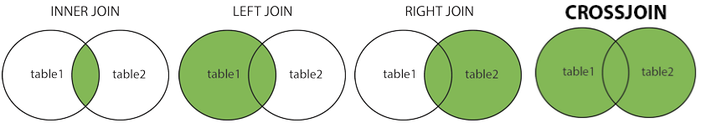
Joins
A JOIN clause is used to combine rows from two or more tables, based on a related column between them.
SELECT Orders.OrderID, Customers.CustomerName, Orders.OrderDate FROM Orders INNER JOIN Customers ON Orders.CustomerID=Customers.CustomerID;
INNER JOIN: Returns records that have matching values in both tables
LEFT JOIN: Returns all records from the left table, and the matched records from the right table
RIGHT JOIN: Returns all records from the right table, and the matched records from the left table
CROSS JOIN: Returns all records from both tables

Slide 67
INNER JOIN
The INNER JOIN keyword selects records that have matching values in both tables.
SELECT Orders.OrderID, Customers.CustomerName FROM Orders INNER JOIN Customers ON Orders.CustomerID = Customers.CustomerID;
Cross join
The CROSS JOIN keyword returns all records from both tables (table1 and table2).
SELECT Customers.CustomerName, Orders.OrderID FROM Customers CROSS JOIN Orders;

Slide 68
LEFT JOIN
The LEFT JOIN keyword returns all records from the left table (table1), and the matching records (if any) from the right table (table2).
SELECT Customers.CustomerName, Orders.OrderID FROM Customers LEFT JOIN Orders ON Customers.CustomerID = Orders.CustomerID ORDER BY Customers.CustomerName;
RIGHT JOIN
The RIGHT JOIN keyword returns all records from the right table (table2), and the matching records (if any) from the left table (table1).
SELECT Orders.OrderID, Employees.LastName, Employees.FirstName FROM Orders RIGHT JOIN Employees ON Orders.EmployeeID = Employees.EmployeeID ORDER BY Orders.OrderID;

Slide 69
Natural join
NATURAL JOIN is such a join that performs the same task as an INNER or LEFT JOIN, in which the ON or USING clause refers to all columns that the tables to be joined have in common.
The MySQL NATURAL JOIN is structured in such a way that, columns with the same name of associate tables will appear once only.
Natural Join: Guidelines:
The associated tables have one or more pairs of identically named columns.
The columns must be the same data type.
Don’t use ON clause in a NATURAL JOIN.
SELECT id,aval1,cval1 FROM table111 NATURAL JOIN table113 WHERE table111.aval1>200;

Slide 70
Introduction to the MySQL Subquery
A MySQL subquery is a query nested within another query. Also, a subquery can be nested within another subquery.
A MySQL subquery is called an inner query while the query that contains the subquery is called an outer query. A subquery can be used anywhere that expression is used and must be closed in parentheses.
A subquery may occur in:
A SELECT clause
A FROM clause
A WHERE clause

Slide 71
Introduction to the MySQL Subquery
In MySQL subquery can be nested inside a SELECT, INSERT, UPDATE, DELETE, SET, or DO statement or inside another subquery.
A subquery is usually added within the WHERE Clause of another SQL SELECT statement.
You can use the comparison operators, such as >, <, or =. The comparison operator can also be a multiple-row operator, such as IN, ANY, SOME, or ALL.
A subquery can be treated as an inner query, which is a SQL query placed as a part of another query called as outer query.
The inner query executes first before its parent query so that the results of the inner query can be passed to the outer query.

Slide 72
Rules for Sub Queries
The following are the rules to use subqueries:
Subqueries should always use in parentheses.
If the main query does not have multiple columns for subquery, then a subquery can have only one column in the SELECT command.
We can use various comparison operators with the subquery, such as >, <, =, IN, ANY, SOME, and ALL. A multiple-row operator is very useful when the subquery returns more than one row.
We cannot use the ORDER BY clause in a subquery, although it can be used inside the main query.

Slide 73
Advantages of Using Subqueries
The following are the advantages of using subqueries:
The subqueries make the queries in a structured form that allows us to isolate each part of a statement.
The subqueries provide alternative ways to query the data from the table; otherwise, we need to use complex joins and unions.
The subqueries are more readable than complex join or union statements.

Slide 74
MySQL Subquery Syntax
Basic Syntax
SELECT column_list (s) FROM table_name
WHERE column_name OPERATOR
(SELECT column_list (s) FROM table_name [WHERE])

Slide 75
Example
We have employee table containing empid, ename, salary, etc.
We need a report of all employees who’s salary is greater than empid=123. But how we know the salary of employee 123?
We can easily handle this in a sub query as:
SELECT empid, ename, salary from employee
WHERE salary > (SELECT salary from employee WHERE empid=123)

Slide 76
Types of Subqueries
We will discuss following types of subqueries.
Comparisons using Subqueries
Subqueries with IN, NOT IN, ALL, ANY
Subqueries with EXISTS or NOT EXISTS
Correlated Subqueries

Slide 77
MySQL Subqueries: Using Comparisons
A subquery can be used before or after any of the comparison operators. The subquery can return at most one value.
The value can be the result of an arithmetic expression or a column function.
SQL then compares the value that results from the subquery with the value on the other side of the comparison operator.
You can use the following comparison operators:

Slide 78
MySQL Subqueries: Using Comparisons
Operator | Description
= | Equal to
> | Greater than
>= | Greater than or equal to
< | Less than
<= | Less than or equal to
!= | Not equal to
<> | Not equal to
<=> | NULL-safe equal to operator

Slide 79
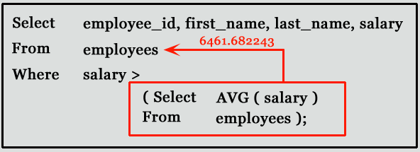
Example
For example: suppose you want to find the employee id, first_name, last_name, and salaries for employees whose average salary is higher than the average salary throughout the company.
Notes:
SELECT employee_id,first_name,last_name,salary FROM employees WHERE salary > (SELECT AVG(SALARY) FROM employees);

Slide 80
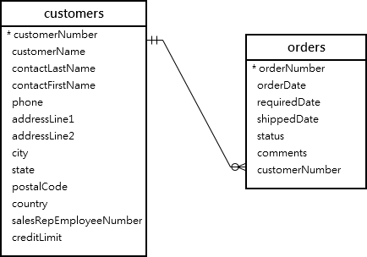
MySQL Subqueries with IN and NOT IN
If a subquery returns more than one value, you can use other operators such as IN or NOT IN operator in the WHERE clause.
Consider the following example tables
Notes:
If a subquery returns more than one value, you can use other operators such as IN or NOT IN operator in the WHERE clause.
Reference:
https://www.mysqltutorial.org/mysql-subquery/

Slide 81
EXAMPLE
For example, you can use a subquery with NOT IN operator to find the customers who have not placed any orders as follows:
SELECT customerName
FROM customers
WHERE customerNumber NOT IN(
SELECT DISTINCT customerNumber
FROM orders);
Notes:
For example, you can use a subquery with NOT IN operator to find the customers who have not placed any orders as follows:
Reference:
https://www.mysqltutorial.org/tryit/query/mysql-subquery/#3

Slide 82
PRACTICE
See the practice questions on slides at the end

Slide 83
MySQL Subqueries with ANY
The ANY operator compares the value to each value returned by the subquery.
Therefore ANY keyword (which must follow a comparison operator) returns TRUE if the comparison is TRUE for ANY of the values in the column that the subquery returns.
Note:
returns a boolean value as a result
returns TRUE if ANY of the subquery values meet the condition

Slide 84
Syntax of ANY
SELECT column_name(s) FROM table_name WHERE column_name operator ANY (SELECT column_name FROM table_name WHERE condition);
Note: The operator must be a standard comparison operator (=, <>, !=, >, >=, <, or <=).

Slide 85
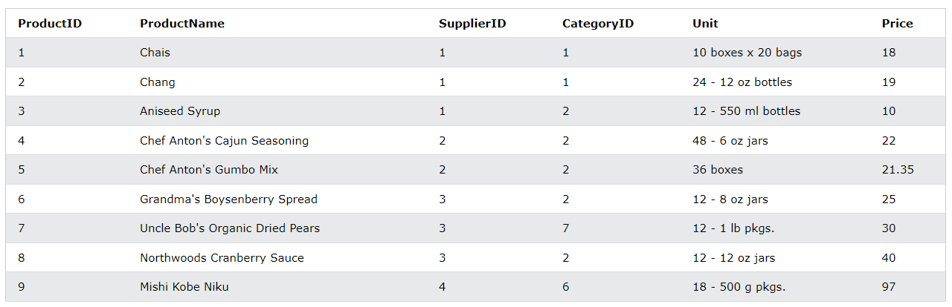
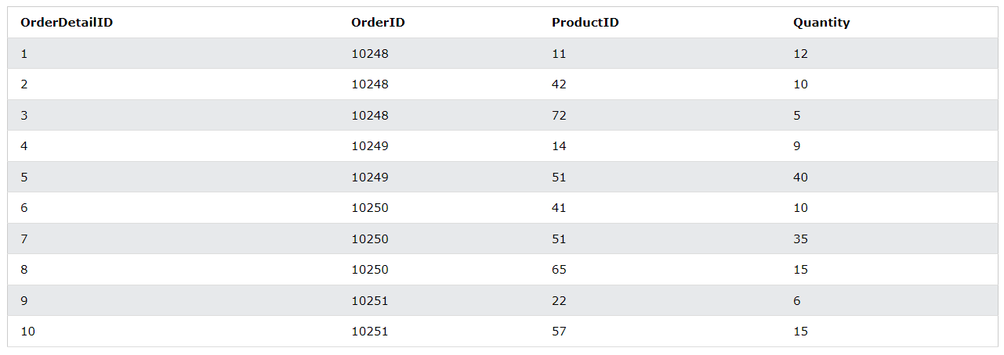
Examples of ANY
Consider following tables: Products and OrderDetails

Slide 86
Examples of ANY
Write a query that lists the ProductName if it finds ANY records in the OrderDetails table has Quantity equal to 10
SELECT ProductName FROM Products WHERE ProductID > ANY (SELECT ProductID FROM OrderDetails WHERE Quantity = 10);
Notes:
SQL statement that statement lists the ProductName if it finds ANY records in the OrderDetails table has Quantity equal to 10 (this will return TRUE because the Quantity column has some values of 10)

Slide 87
Examples of ANY
2. Write a query that lists the ProductName if it finds ANY records in the OrderDetails table has Quantity larger than 99.
SELECT ProductName FROM Products WHERE ProductID = ANY (SELECT ProductID FROM OrderDetails WHERE Quantity > 99);
Notes:
Write a query that lists the ProductName if it finds ANY records in the OrderDetails table has Quantity larger than 99 (this will return TRUE because the Quantity column has some values larger than 99):

Slide 88
Examples of ANY
3. Write a query that lists the ProductName if it finds ANY records in the OrderDetails table has Quantity larger than 1000.
SELECT ProductName FROM Products WHERE ProductID = ANY (SELECT ProductID FROM OrderDetails WHERE Quantity > 1000);
Notes:
Write a query that lists the ProductName if it finds ANY records in the OrderDetails table has Quantity larger than 1000 (this will return FALSE because the Quantity column has no values larger than 1000):

Slide 89
MySQL Subqueries with ALL
ALL means that the condition will be true only if the operation is true for all values in the range.
returns a boolean value as a result
returns TRUE if ALL of the subquery values meet the condition
is used with SELECT, WHERE and HAVING statements
Notes:
ALL means that the condition will be true only if the operation is true for all values in the range.
returns a boolean value as a result
returns TRUE if ALL of the subquery values meet the condition
is used with SELECT, WHERE and HAVING statements

Slide 90
SYNTAX OF ALL
SELECT column_name(s) FROM table_name WHERE column_name operator ALL (SELECT column_name FROM table_name WHERE condition);
Note: The operator must be a standard comparison operator (=, <>, !=, >, >=, <, or <=).

Slide 91
Examples of ALL
Consider following tables: Products and OrderDetails

Slide 92
EXAMPLES OF ALL
The following SQL statement lists the ProductName if ALL the records in the OrderDetails table has Quantity equal to 10. This will of course return FALSE because the Quantity column has many different values (not only the value of 10)
SELECT ProductName FROM Products WHERE ProductID = ALL (SELECT ProductID FROM OrderDetails WHERE Quantity = 10);

Slide 93
PRACTICE
See the practice questions on slides at the end.

Slide 94
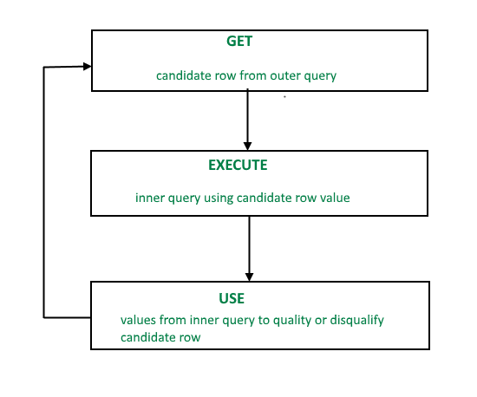

Co-related Nested Query
Correlated subqueries are used for row-by-row processing. Each subquery is executed once for every row of the outer query.
qualify

Slide 95
Co-related Nested Query
A correlated subquery is evaluated once for each row processed by the parent statement. The parent statement can be a SELECT, UPDATE, or DELETE statement.
Synatx:
SELECT column1, column2, .... FROM table1 outer
WHERE column1 operator (SELECT column1, column2 FROM table2 WHERE expr1 = outer.expr2);
Notes:
SELECT column1, column2, .... FROM table1 outer WHERE column1 operator (SELECT column1, column2 FROM table2 WHERE expr1 = outer.expr2);

Slide 96
Co-related Nested Query
A correlated subquery is one way of reading every row in a table and comparing values in each row against related data.
It is used whenever a subquery must return a different result or set of results for each candidate row considered by the main query.
In other words, you can use a correlated subquery to answer a multipart question whose answer depends on the value in each row processed by the parent statement.

Slide 97
Nested Subqueries Versus Correlated Subqueries
With a normal nested subquery, the inner SELECT query runs first and executes once, returning values to be used by the main query. A correlated subquery, however, executes once for each candidate row considered by the outer query. In other words, the inner query is driven by the outer query.
NOTE: You can also use the ANY and ALL operator in a correlated subquery.

Slide 98
EXAMPLES of Correlated Subqueries :
1. Find all the employees who earn more than the average salary in their department.
SELECT last_name, salary, department_id FROM employees outer WHERE salary >
(SELECT AVG(salary) FROM employees
WHERE department_id = outer.department_id
group by department_id);
Notes:
SELECT last_name, salary, department_id FROM employees outer WHERE salary > (SELECT AVG(salary) FROM employees WHERE department_id = outer.department_id group by department_id);

Slide 99
CORRELATED UPDATE
Syntax
UPDATE table1 alias1 SET column =
(SELECT expression FROM table2 alias2 WHERE alias1.column = alias2.column);
Notes:
UPDATE table1 alias1 SET column = (SELECT expression FROM table2 alias2 WHERE alias1.column = alias2.column);

Slide 100
CORRELATED DELETE
Syntax
DELETE FROM table1 alias1 WHERE column1 operator
(SELECT expression FROM table2 alias2 WHERE alias1.column = alias2.column);
Notes:
DELETE FROM table1 alias1 WHERE column1 operator (SELECT expression FROM table2 alias2 WHERE alias1.column = alias2.column);

Slide 101
Using the EXISTS Operator
The EXISTS operator tests for existence of rows in the results set of the subquery.
If a subquery row value is found the condition is flagged TRUE and the search does not continue in the inner query, and if it is not found then the condition is flagged FALSE and the search continues in the inner query.

Slide 102
Examples of EXISTS
Find employees who have at least one person reporting to them.
SELECT employee_id, last_name, job_id, department_id FROM employees outer WHERE EXISTS
( SELECT * FROM employees WHERE manager_id = outer.employee_id);
Notes:
SELECT employee_id, last_name, job_id, department_id FROM employees outer WHERE EXISTS ( SELECT ’X’ FROM employees WHERE manager_id = outer.employee_id);

Slide 103
EXAMPLE of using NOT EXIST
2. Find all departments that do not have any employees.
SELECT department_id, department_name FROM departments d WHERE NOT EXISTS
(SELECT * FROM employees WHERE department_id = d.department_id);
Notes:
SELECT department_id, department_name FROM departments d WHERE NOT EXISTS (SELECT * FROM employees WHERE department_id = d.department_id);

Slide 104
PRACTICE QUESTIONS
Consider the table: employees
EMPLOYEE_ID | FIRST_NAME | LAST_NAME | EMAIL | PHONE_NUMBER | HIRE_DATE | JOB_ID | SALARY | COMMISSION_PCT | MANAGER_ID | DEPARTMENT_ID
100 | Steven | King | SKING | 515.123.4567 | 17-06-87 | AD_PRES | 24000 | 0 | 0 | 90
101 | Neena | Kochhar | NKOCHHAR | 515.123.4568 | 18-06-87 | AD_VP | 17000 | 0 | 100 | 90
102 | Lex | De Haan | LDEHAAN | 515.123.4569 | 19-06-87 | AD_VP | 17000 | 0 | 100 | 90
103 | Alexander | Hunold | AHUNOLD | 590.423.4567 | 20-06-87 | IT_PROG | 9000 | 0 | 102 | 60
104 | Bruce | Ernst | BERNST | 590.423.4568 | 21-06-87 | IT_PROG | 6000 | 0 | 103 | 60
105 | David | Austin | DAUSTIN | 590.423.4569 | 22-06-87 | IT_PROG | 4800 | 0 | 103 | 60
106 | Valli | Pataballa | VPATABAL | 590.423.4560 | 23-06-87 | IT_PROG | 4800 | 0 | 103 | 60
107 | Diana | Lorentz | DLORENTZ | 590.423.5567 | 24-06-87 | IT_PROG | 4200 | 0 | 103 | 60
108 | Nancy | Greenberg | NGREENBE | 515.124.4569 | 25-06-87 | FI_MGR | 12000 | 0 | 101 | 100
109 | Daniel | Faviet | DFAVIET | 515.124.4169 | 26-06-87 | FI_ACCOUNT | 9000 | 0 | 108 | 100
110 | John | Chen | JCHEN | 515.124.4269 | 27-06-87 | FI_ACCOUNT | 8200 | 0 | 108 | 100
111 | Ismael | Sciarra | ISCIARRA | 515.124.4369 | 28-06-87 | FI_ACCOUNT | 7700 | 0 | 108 | 100
112 | Jose Manuel | Urman | JMURMAN | 515.124.4469 | 29-06-87 | FI_ACCOUNT | 7800 | 0 | 108 | 100
113 | Luis | Popp | LPOPP | 515.124.4567 | 30-06-87 | FI_ACCOUNT | 6900 | 0 | 108 | 100
114 | Den | Raphaely | DRAPHEAL | 515.127.4561 | 01-07-87 | PU_MAN | 11000 | 0 | 100 | 30
115 | Alexander | Khoo | AKHOO | 515.127.4562 | 02-07-87 | PU_CLERK | 3100 | 0 | 114 | 30
116 | Shelli | Baida | SBAIDA | 515.127.4563 | 03-07-87 | PU_CLERK | 2900 | 0 | 114 | 30
117 | Sigal | Tobias | STOBIAS | 515.127.4564 | 04-07-87 | PU_CLERK | 2800 | 0 | 114 | 30
118 | Guy | Himuro | GHIMURO | 515.127.4565 | 05-07-87 | PU_CLERK | 2600 | 0 | 114 | 30
119 | Karen | Colmenares | KCOLMENA | 515.127.4566 | 06-07-87 | PU_CLERK | 2500 | 0 | 114 | 30
120 | Matthew | Weiss | MWEISS | 650.123.1234 | 07-07-87 | ST_MAN | 8000 | 0 | 100 | 50
121 | Adam | Fripp | AFRIPP | 650.123.2234 | 08-07-87 | ST_MAN | 8200 | 0 | 100 | 50
122 | Payam | Kaufling | PKAUFLIN | 650.123.3234 | 09-07-87 | ST_MAN | 7900 | 0 | 100 | 50
123 | Shanta | Vollman | SVOLLMAN | 650.123.4234 | 10-07-87 | ST_MAN | 6500 | 0 | 100 | 50
124 | Kevin | Mourgos | KMOURGOS | 650.123.5234 | 11-07-87 | ST_MAN | 5800 | 0 | 100 | 50
125 | Julia | Nayer | JNAYER | 650.124.1214 | 12-07-87 | ST_CLERK | 3200 | 0 | 120 | 50

Slide 105
PRACTICE QUESTIONS
Consider the table: departments
DEPARTMENT_ID | DEPARTMENT_NAME | MANAGER_ID | ATION_ID
10 | Administration | 200 | 1700
20 | Marketing | 201 | 1800
30 | Purchasing | 114 | 1700
40 | Human Resources | 203 | 2400
50 | Shipping | 121 | 1500
60 | IT | 103 | 1400
70 | Public Relations | 204 | 2700
80 | Sales | 145 | 2500
90 | Executive | 100 | 1700
100 | Finance | 108 | 1700
110 | Accounting | 205 | 1700
120 | Treasury | 0 | 1700
130 | Corporate Tax | 0 | 1700
140 | Control And Credit | 0 | 1700
150 | Shareholder Services | 0 | 1700
160 | Benefits | 0 | 1700

Slide 106
PRACTICE QUESTIONS
Consider the table: locations
location_id | street_address | postal_code | city | state_province | country_id
1000 | 1297 Via Cola di Rie | 989 | Roma |  | IT
1100 | 93091 Calle della Te | 10934 | Venice |  | IT
1200 | 2017 Shinjuku-ku | 1689 | Tokyo | Tokyo Prefectu | JP
1300 | 9450 Kamiya-cho | 6823 | Hiroshima |  | JP
1400 | 2014 Jabberwocky Rd | 26192 | Southlake | Texas | US
1500 | 2011 Interiors Blvd | 99236 | South San | California | US
1600 | 2007 Zagora St | 50090 | South Brun | New Jersey | US
1700 | 2004 Charade Rd | 98199 | Seattle | Washington | US
1800 | 147 Spadina Ave | M5V 2L7 | Toronto | Ontario | CA
1900 | 6092 Boxwood St | YSW 9T2 | Whitehorse | Yukon | CA
2000 | 40-5-12 Laogianggen | 190518 | Beijing |  | CN
2100 | 1298 Vileparle (E) | 490231 | Bombay | Maharashtra | IN
2200 | 12-98 Victoria Stree | 2901 | Sydney | New South Wale | AU
2300 | 198 Clementi North | 540198 | Singapore |  | SG
2400 | 8204 Arthur St |  | London |  | UK
2500 | Magdalen Centre, The | OX9 9ZB | Oxford | Oxford | UK
2600 | 9702 Chester Road | 9629850293 | Stretford | Manchester | UK
2700 | Schwanthalerstr. 703 | 80925 | Munich | Bavaria | DE
2800 | Rua Frei Caneca 1360 | 01307-002 | Sao Paulo | Sao Paulo | BR
2900 | 20 Rue des Corps-Sai | 1730 | Geneva | Geneve | CH
3000 | Murtenstrasse 921 | 3095 | Bern | BE | CH
3100 | Pieter Breughelstraa | 3029SK | Utrecht | Utrecht | NL
3200 | Mariano Escobedo 999 | 11932 | Mexico Cit | Distrito Feder | MX

Slide 107
PRACTICE QUESTIONS
Consider the table: jobs
JOB_ID | JOB_TITLE | MIN_SALARY | MAX_SALARY
AD_PRES | President | 20000 | 40000
AD_VP | Administration Vice President | 15000 | 30000
AD_ASST | Administration Assistant | 3000 | 6000
FI_MGR | Finance Manager | 8200 | 16000
FI_ACCOUNT | Accountant | 4200 | 9000
AC_MGR | Accounting Manager | 8200 | 16000
AC_ACCOUNT | Public Accountant | 4200 | 9000
SA_MAN | Sales Manager | 10000 | 20000
SA_REP | Sales Representative | 6000 | 12000
PU_MAN | Purchasing Manager | 8000 | 15000
PU_CLERK | Purchasing Clerk | 2500 | 5500
ST_MAN | Stock Manager | 5500 | 8500
ST_CLERK | Stock Clerk | 2000 | 5000
SH_CLERK | Shipping Clerk | 2500 | 5500
IT_PROG | Programmer | 4000 | 10000
MK_MAN | Marketing Manager | 9000 | 15000
MK_REP | Marketing Representative | 4000 | 9000
HR_REP | Human Resources Representative | 4000 | 9000
PR_REP | Public Relations Representative | 4500 | 10500

Slide 108
PRACTICE QUESTIONS
Write a query to find the name (first_name, last_name) and the salary of the employees who have a higher salary than the employee whose last_name=‘Bull’
Write a query to find the name (first_name, last_name) of all employees who works in the IT department.
Write a query to find the name (first_name, last_name) of the employees who have a manager and worked in a USA based department.
Write a SQL query to find those employees who earn more than the average salary. Return employee ID, first name, last name.
write a SQL query to find those employees whose department is located at ‘Toronto’. Return first name, last name, employee ID, job ID.
Write a SQL query to find those employees who report to that manager whose first name is ‘Payam’. Return first name, last name, employee ID and salary

Slide 109
PRACTICE QUESTIONS
Write a SQL query to find all those departments where at least one employee is employed. Return department name
write a SQL query to find those employees who do not work in the departments where managers’ IDs are between 100 and 200 (Begin and end values are included.). Return all the fields of the employees
From the following table, write a SQL query to find those employees whose salary matches the lowest salary of any of the departments. Return first name, last name and department ID.
Write a query to find the name (first_name, last_name) of the employees who are managers.
write a SQL query to find those employees whose salary is lower than that of employees whose job title is "MK_MAN". Exclude employees of Job title ‘MK_MAN’. Return employee ID, first name, last name, job ID
Write a query to find the name (first_name, last_name), and salary of the employees whose salary is greater than the average salary.

Slide 110
PRACTICE QUESTIONS
13. Write a query to find the name (first_name, last_name), and salary of the employees whose salary is equal to the minimum salary for their job grade.
14. Write a query to find the name (first_name, last_name), and salary of the employees who earns more than the average salary and works in any of the IT departments.
15. Write a query to find the name (first_name, last_name), and salary of the employees who earns more than the earning of Mr. Bell.
16. Write a query to find the name (first_name, last_name), and salary of the employees who earn the same salary as the minimum salary for all departments.
17. Write a query to find the name (first_name, last_name), and salary of the employees whose salary is greater than the average salary of all departments.
18. Write a query to find the 3rd maximum salary in the employees table.
Notes:
(Using correlated query)

